Slide 1

Analysis of UFO Sightings in California
Greg Johnson Math 531T – Spatial Statistics Summer 2016

Slide 2
Background
Unidentified Flying Object
The National UFO Reporting Center
Online self-report submission
Database of reports
12,250 reports in California since 1935
Notes:
Disclaimer: I don’t believe in UFOs.
Hopefully everyone knows what a UFO is – it’s in the name!
There’s a website called the national UFO reporting center where they collect self-reports of UFO.
National makes it sound super official and it’s not, but the guys who run it are super into UFOs: making sure reports sound legit, doing reports of certain incidents, telephone hotline. So while I think they’re kind of crazy, I can believe that they want good data.

Slide 3
Data
N = 4312 reports over a 6 year period (2010 - 2015)
Data are of reports not occurrences
Hoax/joke reports are supposedly filtered out
Report:
Event Date and Time
State
Location/City
Description
UFO characteristics
Close Encounter details
Notes:
Subset the data from 2010 to 2015, leaving me with 4312 reports. I just wanted to work with recent, full calendar-years.
It’s important to keep in mind that the data are the reports of UFOs, not the occurrences themselves. So there could be occurrences that were never reported and there could be multiple reports of the same occurrence from different people. So when interpreting these data, we could assume that it’s a rough proxy/measure of the occurrences themselves but we need to be careful.
The center claims that they filter out hoax reports but they’re not transparent about their process or their criteria.

Slide 4
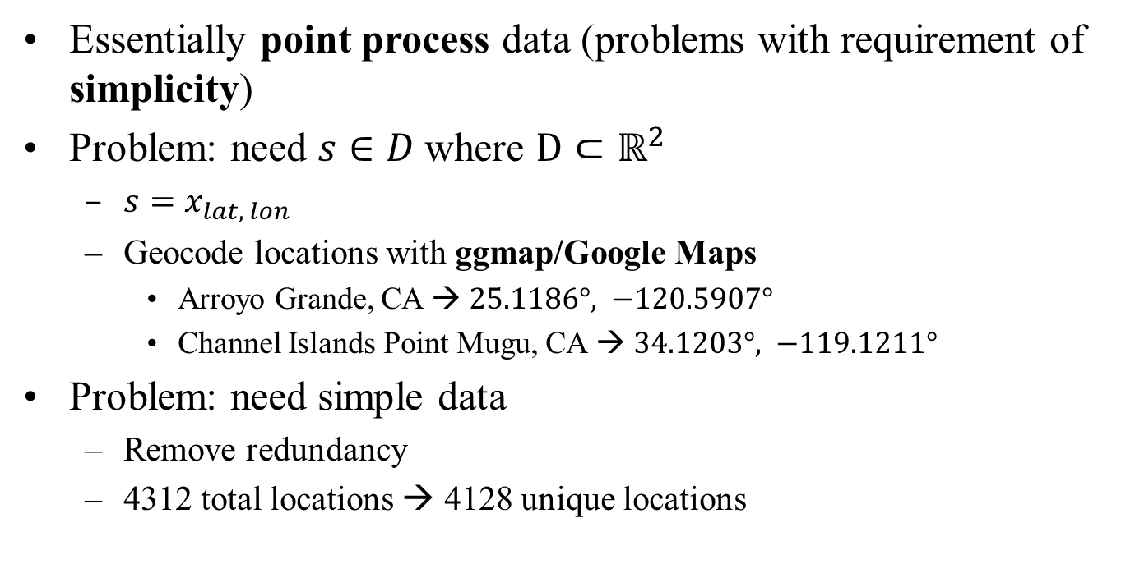
Pre-Processing Data
Essentially point process data (problems with requirement of simplicity)
Problem: need $s∈D$where $D⊂ℝ^{2}$
$s=x_{lat, lon}$
Geocode locations with ggmap/Google Maps
Arroyo Grande, CA → $25.1186°, −120.5907°$
Channel Islands Point Mugu, CA → $34.1203°, −119.1211°$
Problem: need simple data
Remove redundancy
4312 total locations → 4128 unique locations

Slide 5
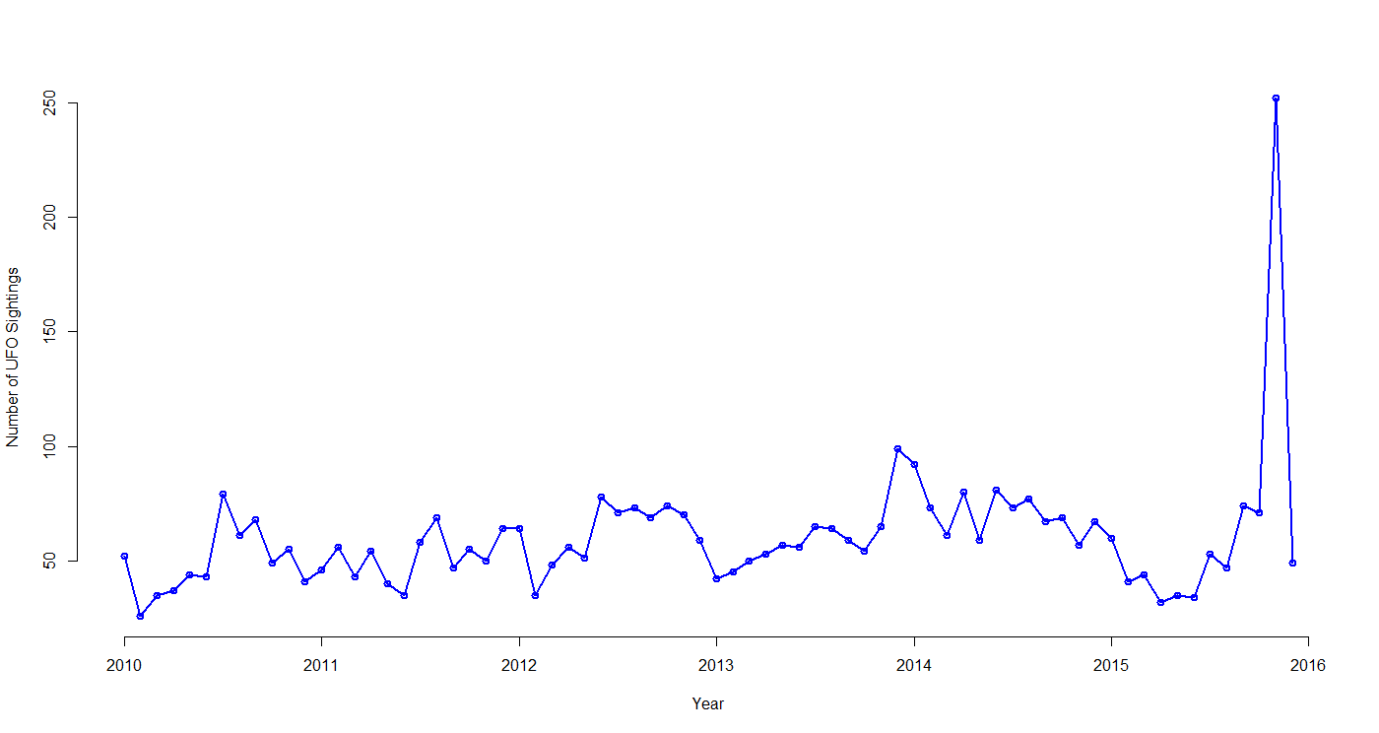
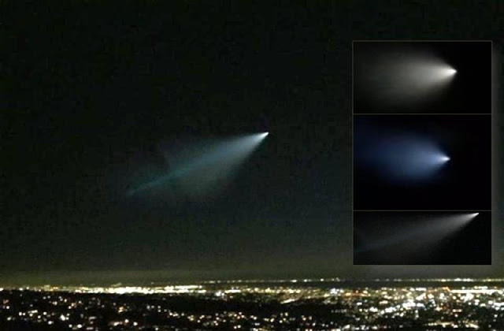
Data as a Time Series
11/7/15

Slide 6
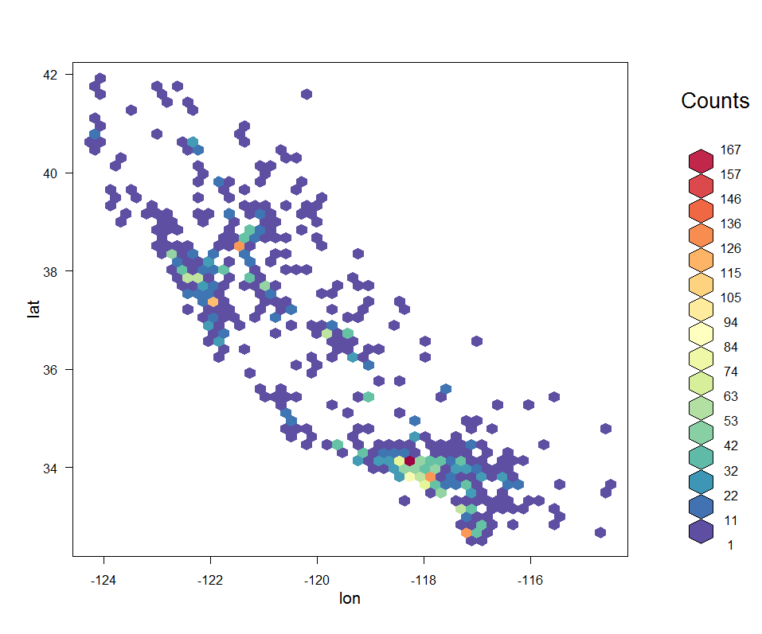
Hexbin Heatmap

Slide 7
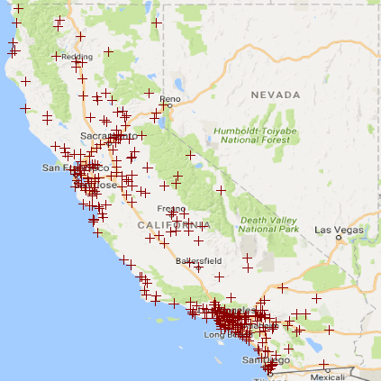
Realizations: 2010

Slide 8
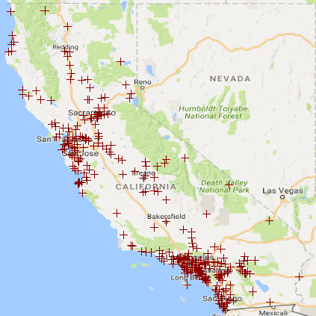
Realization: 2011

Slide 9

Realization: 2012

Slide 10
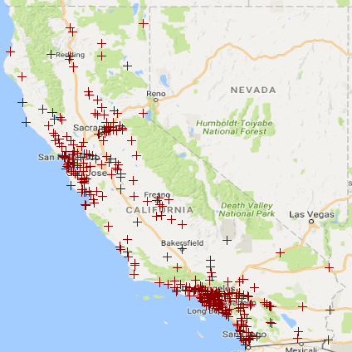
Realization: 2013

Slide 11

Realization: 2014

Slide 12
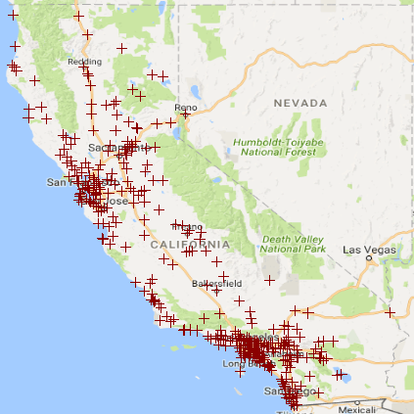
Realization: 2015

Slide 13
Monthly Realizations

Slide 14
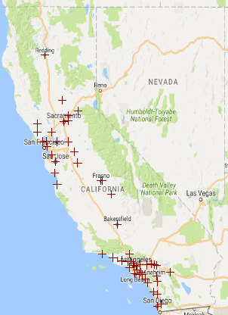
Typical Month
What is a typical month of UFO sightings in California?

Slide 15
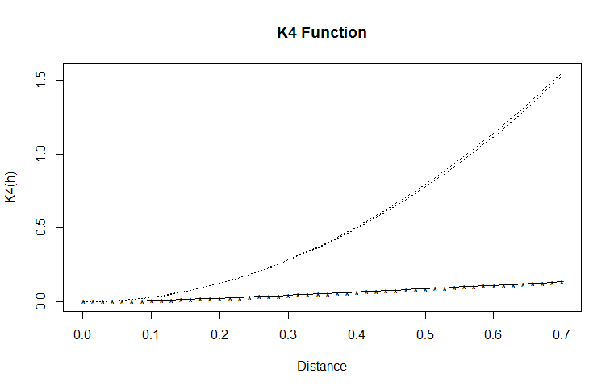
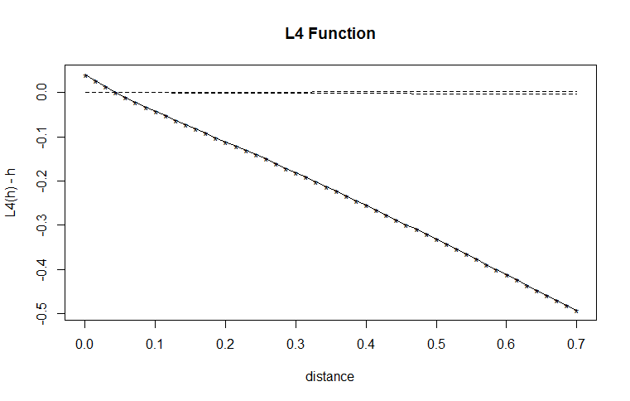
Ripley’s K and H Functions
Clearly inhomogeneous from the realizations.
What about K and H functions?

Slide 16
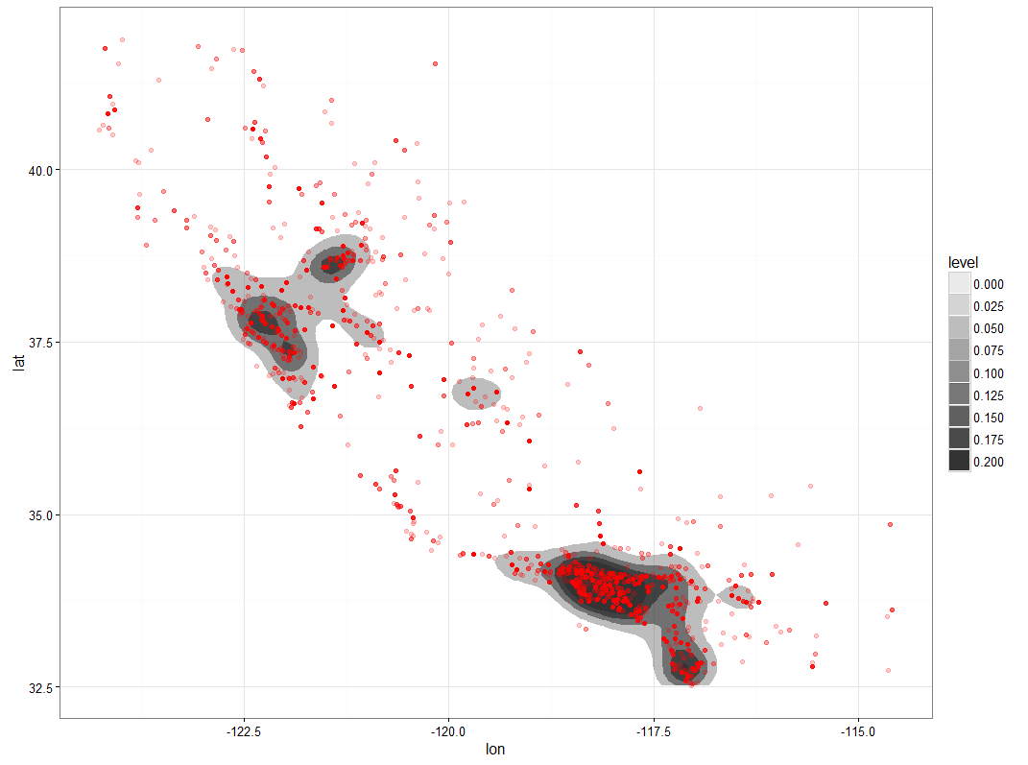
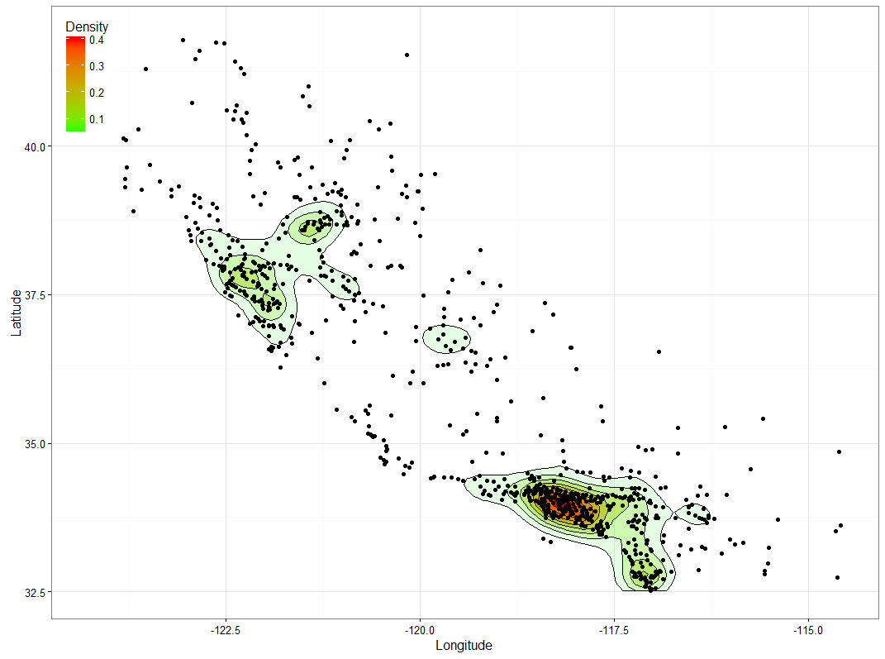
Kernel Density Estimate

Slide 17
Conclusions & Future Directions
Conclusions
Inhomogeneous: expected number of UFO sightings differs based on location. No clustering.
Future Directions
Just population density? Maybe normalized geostatistical data by county/zip code?
Clustering happens at a shorter time scale?

